Slide 1



Self-Service Data Provisioning through Semantic Enrichment of Data
Ahmad Assaf †
Supervised by:
Aline Senart† and Raphaël Troncy‡
†SAP Research, SAP Research France SAS
‡EURECOM, Sophia Antipolis - France
March 13, 2014
Public

Slide 2
Problem Statement Data Integration in the Enterprise
Enterprises use a wide range of heterogeneous information systems in their business activities such as Enterprise Resource Planning (ERP), Customer Relationships Management (CRM) and Supply Chain Management (SCM) systems.
Data Integration in large enterprises is a time and resource costly task
Enterprise Big Data isn't big in volume only, but in the associated le formats also as the information is being stored often in unstructured and unknown formats.
Data Integration in large enterprises is a time and resource costly task
Various approaches have been introduced to solve this integration challenge:
XML as the underlying data model
Web Services to provide the data exchange protocols and Service Oriented Architecture (SOA)
Linked Data paradigm

Slide 3

Problem Statement Business Intelligence Graph (BIG)
For example, recommendation engines built on top of the Business Intelligence stack need user profile information. Building rich user profiles requires integrating data from LDAP directories, online Wikis, communities … etc.
The Business Intelligence Graph (BIG) is a set of foundation services for BI applications such as SAP Lumira to simplify the experience of Decision Makers and Analysts.
BIG Harvest BI artefacts, BI usage and user profiles and store them in the HANA Graph Engine.
In addition to internal enterprise data integration, data residing in external repositories (data hubs, structured data in web pages, Linked Open Data … etc.) can bring new insights and enhance decision making process.

Slide 4
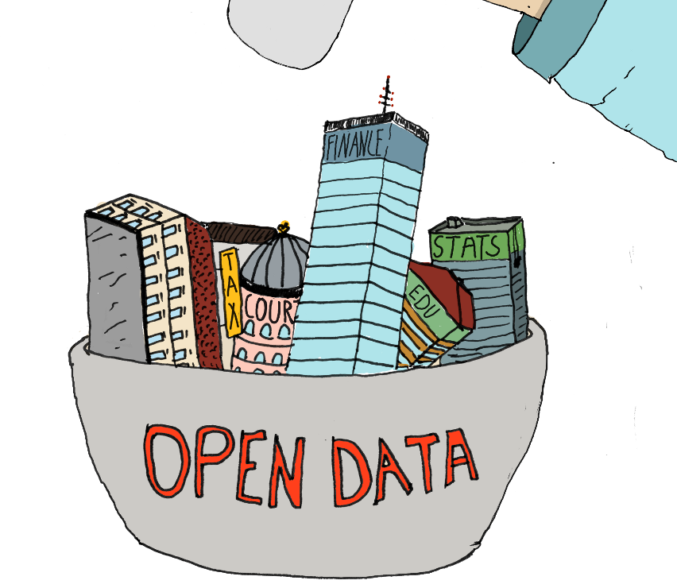
Problem Statement There is Money in Linked Open Data
From 12 datasets cataloged in 2007, the Linked Open Data has grown to almost 300 datasets
32 billion triples
Covering areas in education, transportation, consumer products, electricity, oil and gas, health care and consumer finance
The potential annual value enabled by Open Data in these domains estimates to reach 3 trillion US Dollars .
“More Data beats better Algorithms”
But … is all data good data ?! Especially for enterprise use ?!
How will I be able to find relevant, good quality and license friendly data in this haystack ?!

Slide 5
Related Work
There is a plethora of open online data portals like data.gov, publicdata.eu or private ones like Enigma or Quandl that provide search interfaces on top of their repository.
Open portals data quality depends on the raw quality of the data supplied by the publisher, whereas private portals manually curate and annotate their data.
To our knowledge, Microsoft is the only company that managed to provide self serviced data provisioning through the Data Explorer (now called Power Query).
Power Query integrates data coming from Text based sources (plain text, CSV), XML Excel files … etc. and Web sources supported include Tables on web pages, Web APIs / JSON and Odata
There are limited public data sources accessible from Power Query:
A subset of Data.gov
The World Bank
HealthData.gov
Wikipedia Tables

Slide 6
Proposal
Self Service data provisioning aims at providing datasets discovery, acquisition and integration techniques intuitively to the end user.
DCAT Index
Semantic Annotator
Statistical Profiler
Data Quality Control
Data Profiler
Data Crawler
Open Data
Wikipedia
Web Data

Slide 7
Proposal Use Cases – Data Augmentation through Search
Here i will put a screenshot of Lumira Server with a search panel on the right hand side, search box with pollution entered and a set of search results from different data sources .. And another where we showcase the recommendation part when we have a chart and the user is prompted with a set of suggestions to augment to his chart
I just need access to Lumira server in SAP to take screenshots
These two slides will present the use cases

Slide 8
Proposal Use Cases – Data Augmentation through Recommendation
Here i will put a screenshot of Lumira Server with a search panel on the right hand side, search box with pollution entered and a set of search results from different data sources .. And another where we showcase the recommendation part when we have a chart and the user is prompted with a set of suggestions to augment to his chart
I just need access to Lumira server in SAP to take screenshots
These two slides will present the use cases

Slide 9
Challenges
Dataset integration and enrichment: Large scale data integration requires techniques that can automatically annotate datasets with rich semantic tags.
Attaching metadata and Semantic information to instances can be tricky, especially finding the most relevant entity type within a given context.
Integrating information from Social Networks can be tricky due to the vast amount of data available which makes hard to spot what is relevant in a timely manner.
Dataset Discovery: Even though popular datasets like DBpedia and Freebase are well known and widely used there are other hidden useful datasets that are difficult to find
Dataset Quality Control: Linked Data consists of structured information supported by models, ontologies and vocabularies and contains query endpoints and links. This makes data quality assurance a challenge.

Slide 10
Challenges Dataset Integration and Enrichment – Semantic Annotation
DCAT Index
Semantic Annotator
Statistical Profiler
Data Quality Control
Data Profiler
Data Crawler
Open Data
Wikipedia
Web Data

Slide 11
Challenges Dataset Integration and Enrichment – Semantic Annotation
RUBIX is a framework that annotates datasets based on the semantics of the data at the instance level
Uses Reference Datasets like DBpedia and Freebase
Able to overcome lots of tradition data integration problems like synonyms, spelling mistakes, different languages, abbreviations … etc.
Improves Schema Matching
Uses Cosine Similarity, Pearson Product-Moment Correlation Coefficient(PPMCC) and Spearman's Rank Correlation Coefficient

Slide 12
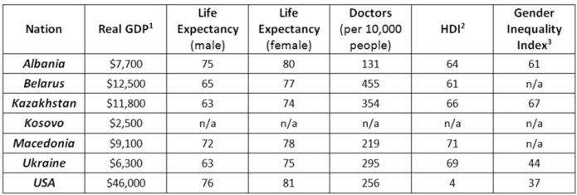
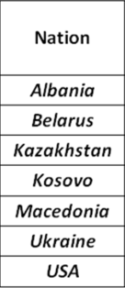
Challenges Dataset Integration and Enrichment – Semantic Annotation
Instead of looking at the table as a set of records with strings, RUBIX represents each instance at the cell level with a set of types retrieved from Freebase
The column will be represented now as a victor of rich types and their corresponding confidence from Freebase
The confidence score for each type is query independent
By normalizing the confidence scores, and aggregating the set of types we are able to select top-N “topics” to annotate that specific column.
The top aggregate type can be used to semantically label column headers
PL_C
PL_C
PL_C
country:87,3212, music album:12,331,Order of Chivalry:11,2321
……
…….

Slide 13
Challenges Dataset Integration and Enrichment – Semantic Annotation
Evaluated against data coming from two SAP systems: The Event Tracker and Travel Expense Manager
The data used in our evaluation consists of around 60 columns and more than 1000 rows.
We proved that using our techniques we managed not only to increase the average confidence score with an average of 11% but also increase the number of valid matches found
Columns now are labeled with new semantic labels that are unified across datasets with the same content types
Extra data can be augmented using the semantic links to Freebase, DBPedia …

Slide 14
Challenges Dataset Integration and Enrichment – Important Entities
Entities play a key role in knowledge bases in general and in the Web of Data in particular and they are generally described with a lot of properties.
It is, however, difficult to assess which ones are more "important" than others for data integration.
we reverse engineered the Google Knowledge graph panel to find out what are the most "important" properties for an entity according to Google.
We compared these results with a survey we conducted on 152 users and show how we can represent and explicit this knowledge using the Fresnel vocabulary.

Slide 15
Challenges Dataset Integration and Enrichment – Social Media
SNARC is a service that extracts the semantic context of documents in order to recommend related content from the web and social media. SNARC enriches the user experience by allowing the user to get fresh perspective on what is happening as well as knowledge about identified concepts.
The main idea behind SNARC is to provide a uniform semantic document model for web entities, whether they are blog entries, multimedia objects or micro-posts
SNARC federates queries with topics identified from extracted entities in the semantic document model
SNARC reconciles the results fetched to ensure their alignment and relevancy with the underlying model
SNARC has been implemented as a Chrome extension, but we plan to integrate it with business applications
The input for SNARC will be the annotations (entities, topics, categories) attached to data sources.
Winner of the AI Mash-up Challenge at ESWC13

Slide 16
Challenges Dataset Quality Control
DCAT Index
Semantic Annotator
Statistical Profiler
Data Quality Control
Data Profiler
Data Crawler
Open Data
Wikipedia
Web Data

Slide 17
An Objective Assessment Framework for Linked Data Quality – The Problem
Data quality involves data management, modeling, analysis, storage and presentation
It is an important issue for data driven applications which should be deeply investigated and understood in order to ensure the data is fit to be combined and used to infer better business decisions
Data quality is subjective and cannot be assessed easily, the actual value of data is mainly realized when it is used
Studies found out that most data quality problems are in fact “data misinterpretations” or problems with the data semantics
Openness should be accompanied with a certain level of trust or guarantees about the quality of data
With the rise of Semantic Web, new data quality principles should be identified

Slide 18
An Objective Assessment Framework for Linked Data Quality – Contribution
We have surveyed the landscape of Linked Data quality assessment frameworks.
We have surveyed the landscape of Linked Data quality assessment tools (25+ different tools).
Suggested an Objective Linked Data Quality Framework that consists of 13 different quality attribute
To measure these abstract attributes, we have identified a total of 79 quality indicators

Slide 19
An Objective Assessment Framework for Linked Data Quality – Contribution
Building on the main four principles for publishing Linked Data, we grouped the quality attributes into four main categories:
Quality of the entities : quality indicators that focus on the data at the instance level (i.e. syntactic checkers).
Quality of the dataset: quality indicators at the dataset level.
Quality of the semantic model: quality indicators that focus on the semantic models, vocabularies and ontologies.
Quality of the linking process: quality indicators that focus on the inbound and outbound links between datasets.

Slide 20
An Objective Assessment Framework for Linked Data Quality – Contribution
The Linked Data quality tools were grouped to reflect the different aspects of LOD:
Information Modeling Quality
Ontologies and Vocabularies Quality
Dataset Quality
Manual Ranking Tools
Automatic Ranking Tools
Links Based Approach
Provenance-based Approach
Entity-based Approach
Queryable End-point Quality
we identified several gaps in the current tools and identified the need for a
comprehensive evaluation and assessment framework

Slide 21
Thank You!
Contact information:
Ahmad Assaf
www.ahmadassaf.com
@ahmadaassaf
SAP Research, France
Ahmad.assaf@sap.com
+33 695 436 614

